Slide 1
Week 02
Contents:
Descriptive Statistics
1. Stem-and-Leaf diagrams
2. Histograms
3. Measures of the Location of the Data

Slide 2
Stem and Leaf Diagram
This is a technique used for simultaneously sorting and displaying the data sets, where each number in the data set is divided into two parts, a Stem and a Leaf. A Stem is a leading digit(s) of each number and used in sorting, while Leaf is the rest of the number or trailing digit(s). A vertical line separates the leaf from stem. Example 01: Analyzing Response Times in a Web Server
A web server records response times (in milliseconds) for 15 requests:
125, 132, 128, 141, 149, 156, 161, 175, 182, 190, 193, 198, 201, 209, 212
A stem-and-leaf plot helps in quick visualization:

Slide 3
Continue…
12 | 5 8
13 | 2
14 | 1 9
15 | 6
16 | 1
17 | 5
18 | 2
19 | 0 3 8
20 | 1 9
21 | 2

Slide 4
Useful Insights
The response times mostly range between 125 ms and 212 ms.
The distribution is slightly right-skewed, meaning some requests take significantly longer.
Example no 02:
A programmer records the execution time (in milliseconds) of an algorithm:
10, 12, 15, 18, 20, 22, 25, 30, 32, 35, 50, 55, 100

Slide 5
Continue…
1 | 0 2 5 8
2 | 0 2 5
3 | 0 2 5
5 | 0 5
10 | 0
Useful Insights
Most executions are between 10-35 ms.
Some runs took 100 ms, indicating possible inefficiency.

Slide 6
Conclusion
Stem-and-leaf plots are powerful tools in computer science for:
✅ Quick data visualization ✅ Sorting and indexing improvements ✅ Performance monitoring

Slide 7
Histograms
A histogram consists of contiguous (adjoining) boxes. It has both a horizontal axis and a vertical axis. The horizontal axis is labelled with what the data represents (for instance, distance from your home to school). The vertical axis is labelled either frequency or relative frequency (or percent frequency or probability). The histogram can give you the shape of the data, the center, and the spread of the data.
STEPS TO CONSTRUCT THE HISTOGRAM:
1. First check how many bars or intervals, also called classes, representing the data. Generally, many histograms consist of five to 15 bars or classes.
2. A convenient starting point.
3. The height of the bars depends on the frequency of that class or the relative frequency.
4. There will be no gap between the classes’ bars.

Slide 8
Website Load Time Analysis
A company tracks the website load times (in seconds) for 50 users:
1.2, 1.5, 1.8, 2.0, 2.1, 2.5, 2.8, 3.0, 3.2, 3.5, 3.8, 4.0, 4.2, 4.5, 5.0,
5.5, 6.0, 6.5, 7.0, 7.5, 8.0, 8.5, 9.0, 9.5, 10.0, 10.5, 11.0, 12.0, 12.5, 13.0
Question:
Construct a histogram for the given load times using bins of 2 seconds.
What is the most common load time range?
Identify the slowest loading time.
What percentage of users experience a load time greater than 6 seconds?

Slide 9
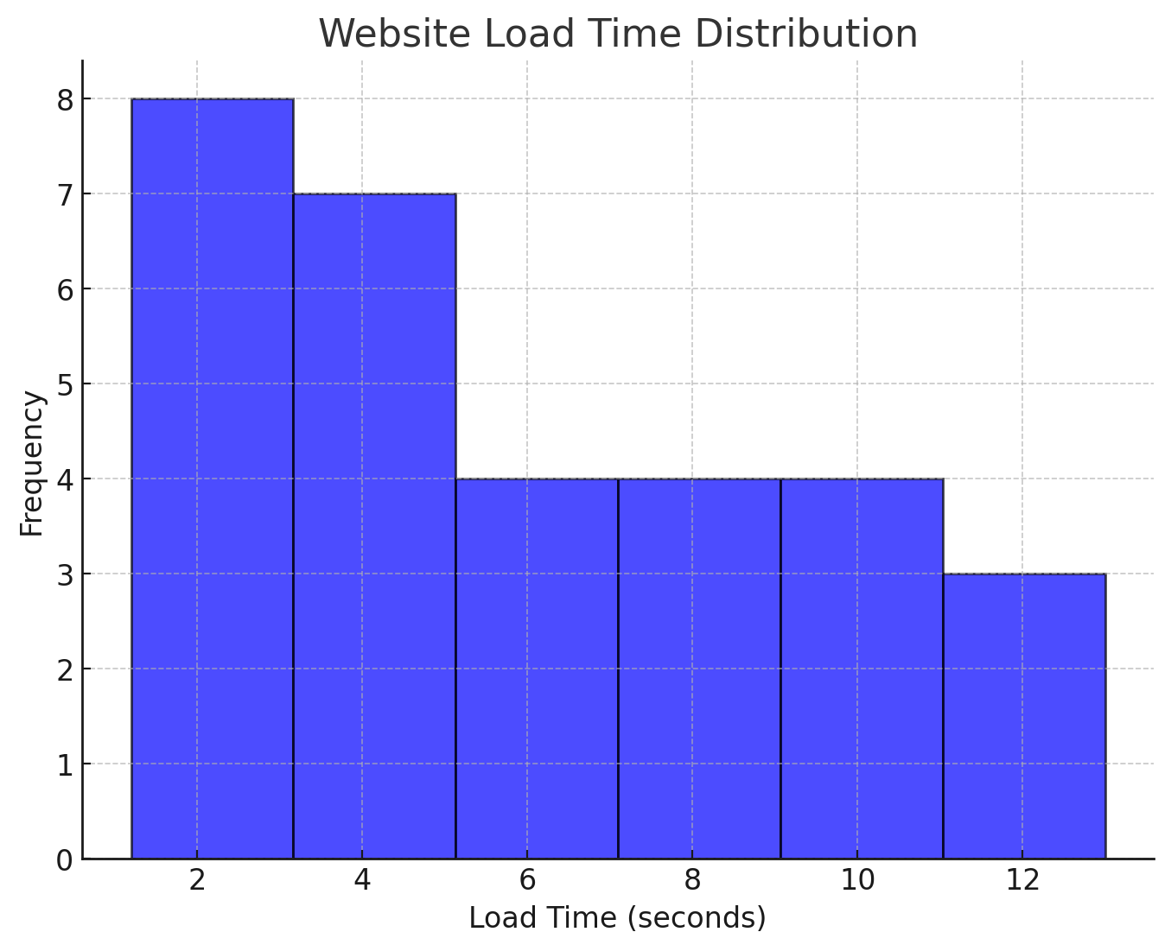
Continue…

Slide 10
The histogram above groups the data into six bins of 2 seconds each. Each bin represents a range of 2 seconds (e.g., 0-2s, 2-4s, 4-6s, etc.), and the height of each bar indicates the number of load times in that range.
What is the most common load time range?
The most frequent load time range is 2–4 seconds, as it has the highest bar in the histogram.
Identify the slowest loading time
The slowest loading time in the dataset is 13.0 seconds.
What percentage of users experience a load time greater than 6 seconds?
Step 1: Count the number of users with load times greater than 6 seconds:

Slide 11
Continue…
6.5, 7.0, 7.5, 8.0, 8.5, 9.0, 9.5, 10.0, 10.5, 11.0, 12.0, 12.5, 13.0
Total users in this range: 13
Step 2: Calculate the percentage:
(13/30) * 100 = 43. 33%
Answer: 43.33% of users experience load times greater than 6 seconds.

Slide 12
Measures of the Location of the Data
Measures of location (also called measures of central tendency) help identify a representative value in a dataset. These values tell us where most of the data points "center" around or how they are distributed.
Commonly used measures include:
Mean (Arithmetic Average) – The sum of all values divided by the total number of values.
Median (Middle Value) – The middle value when data is arranged in ascending order.
Mode (Most Frequent Value) – The value that appears most frequently.
Percentiles & Quartiles – Values that divide data into equal parts, often used in performance analysis.

Slide 13
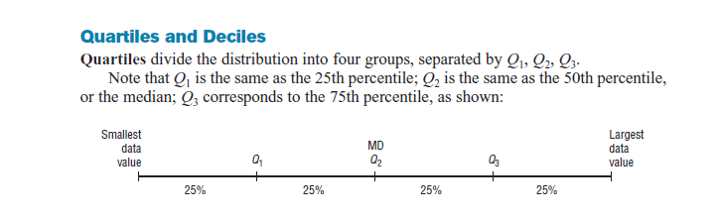
Quartiles and Deciles:

Slide 14
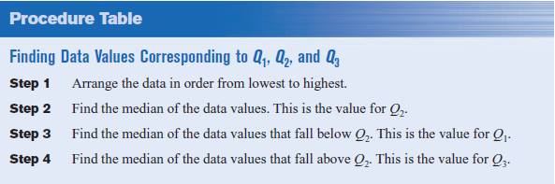
Procedure Table

Slide 15
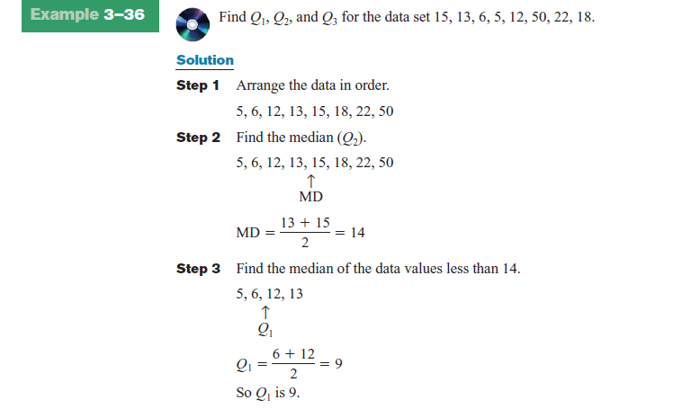

Slide 16
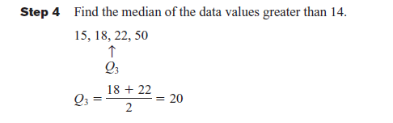

Slide 17
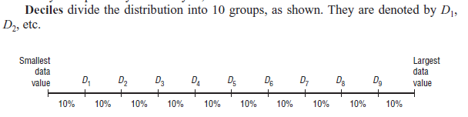
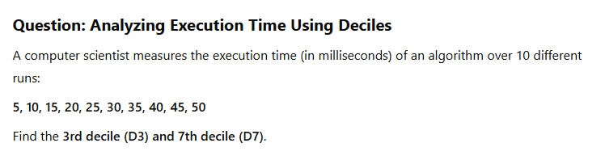
Deciles

Slide 18
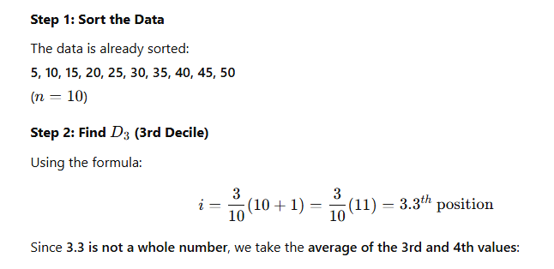
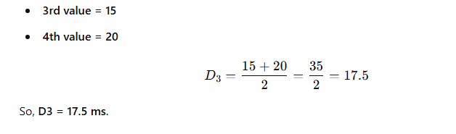

Slide 19
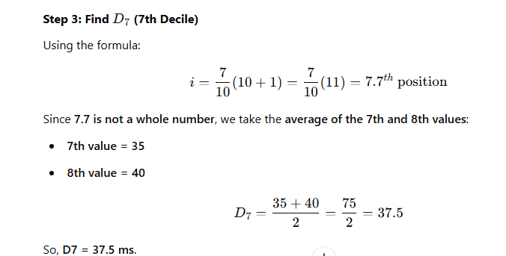

Slide 20
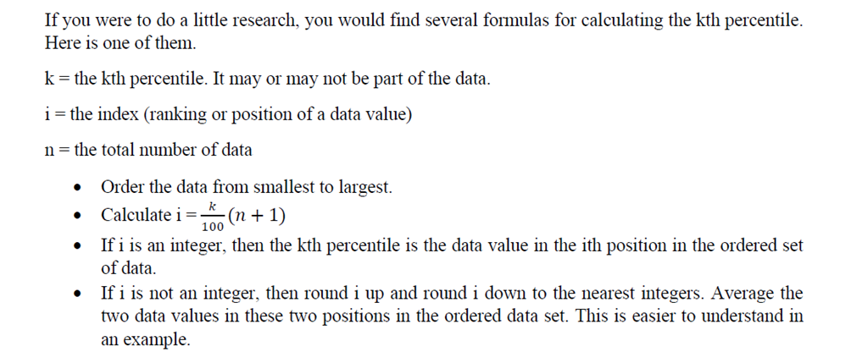
A Formula for Finding the Kth Percentile

Slide 21
Question:
A network administrator collects latency (response time in milliseconds) data for a web server. The recorded response times (in ascending order) are:
12,18,20,25,30,35,40,42,50,55,60,65,70,75,80
Find:
The 25th percentile (P₂₅)
The 90th percentile (P₉₀)

Slide 22
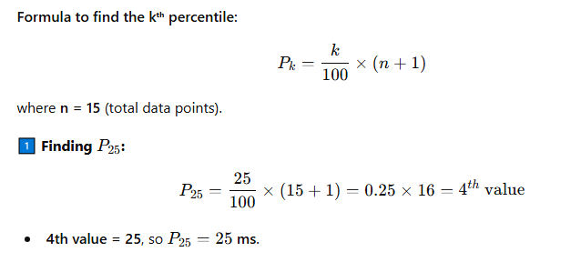
Continue…

Slide 23
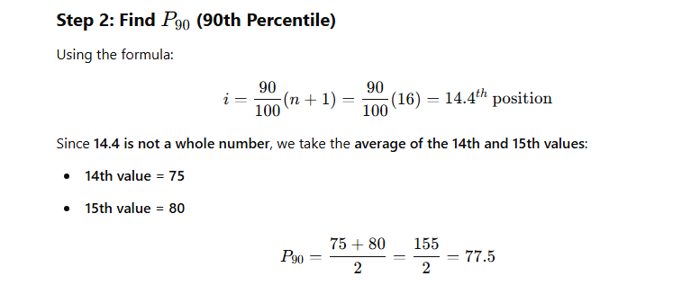
Continue…

Slide 24
Question 2:
A programmer measures the execution time (in milliseconds) of a sorting algorithm on different input sizes. The recorded times (sorted) are:
5,7,9,10,12,15,18,20,25,30,35,40,45,50,55,60,70,80. Find:
50th percentile (P₅₀)
75th percentile (P₇₅)

Slide 25
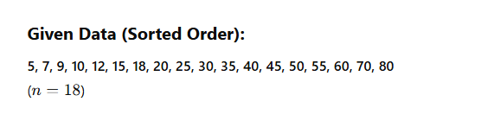
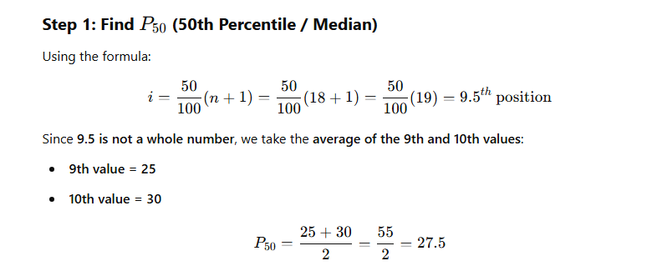

Slide 26


Slide 27
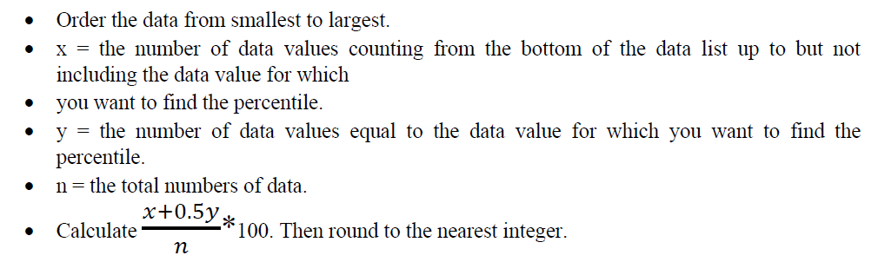
A Formula for finding the Percentile of a Value in a Data Set

Slide 28
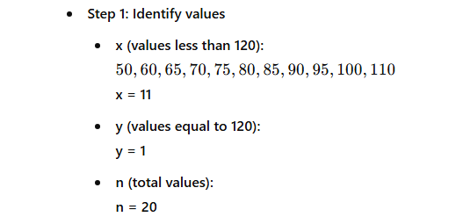
Question:
A web application logs response times (in milliseconds) from different user requests:
50,60,65,70,75,80,85,90,95,100,110,120,130,140,150,160,170,180,190,200. Find the percentile rank of 120 ms.

Slide 29
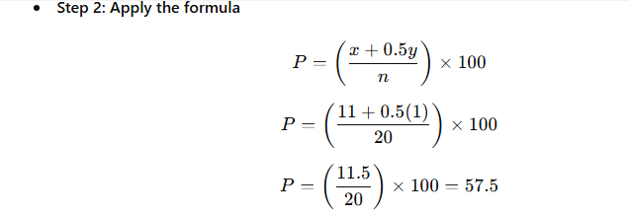
Continue…

Slide 30
Useful Insights
Application in Web Performance Analysis:
Helps in analyzing user experience—if 120 ms is the 57.5th percentile, it means 57.5% of requests are faster and 42.5% are slower.
Can be used to optimize server response time and detect bottlenecks.

Slide 31
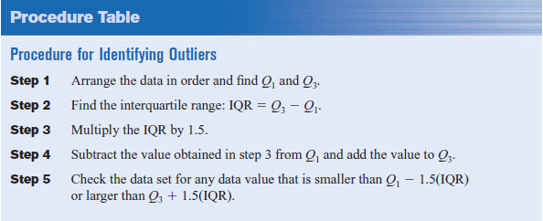
Outliers

Slide 32
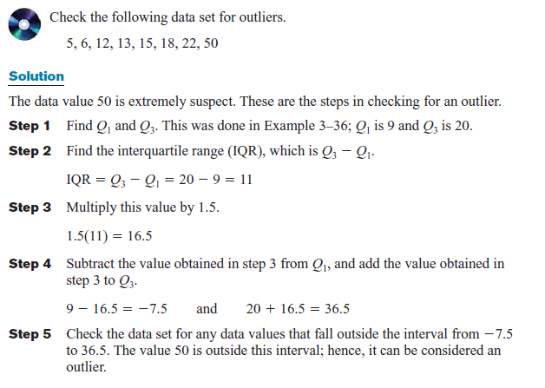
Example

